Slide 1
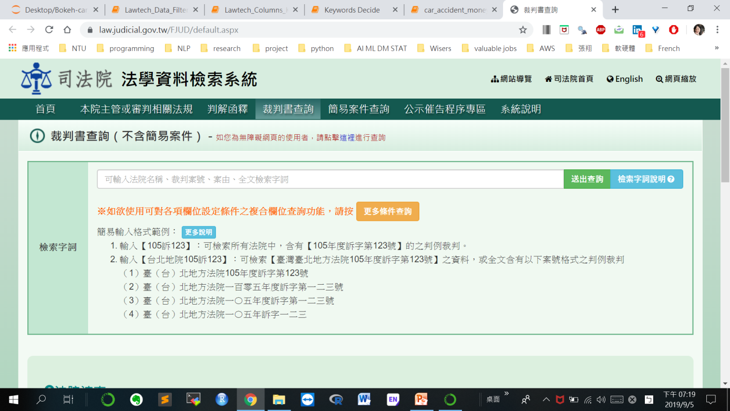
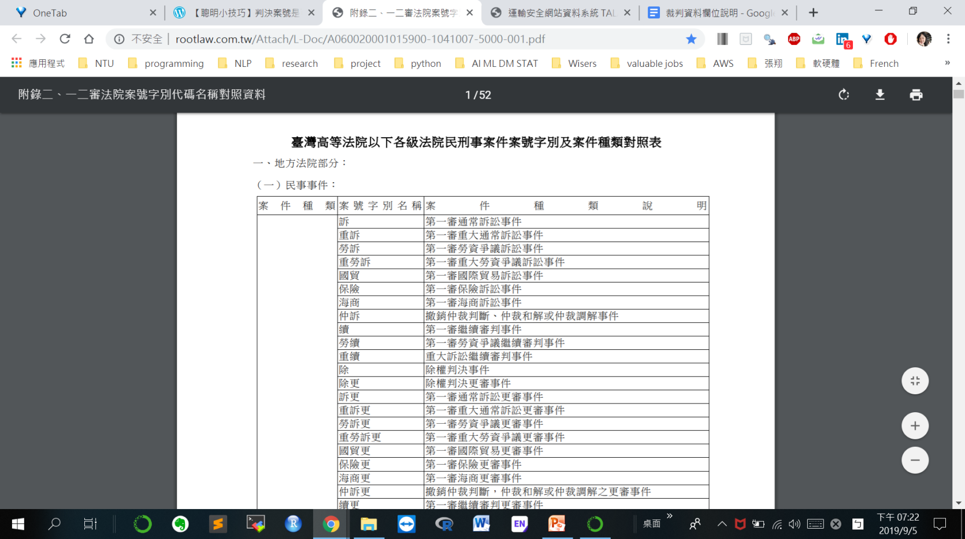
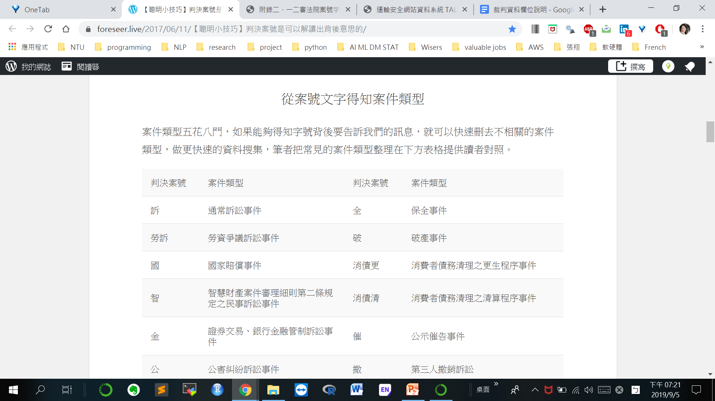
車禍資料篩選
1500000 -> 6510
案號篩選
破 : 破產事件
消 : 消費訴訟事件
6510 -> 6426
Domain
Knowledge
Coding Skill
User Study

Slide 2
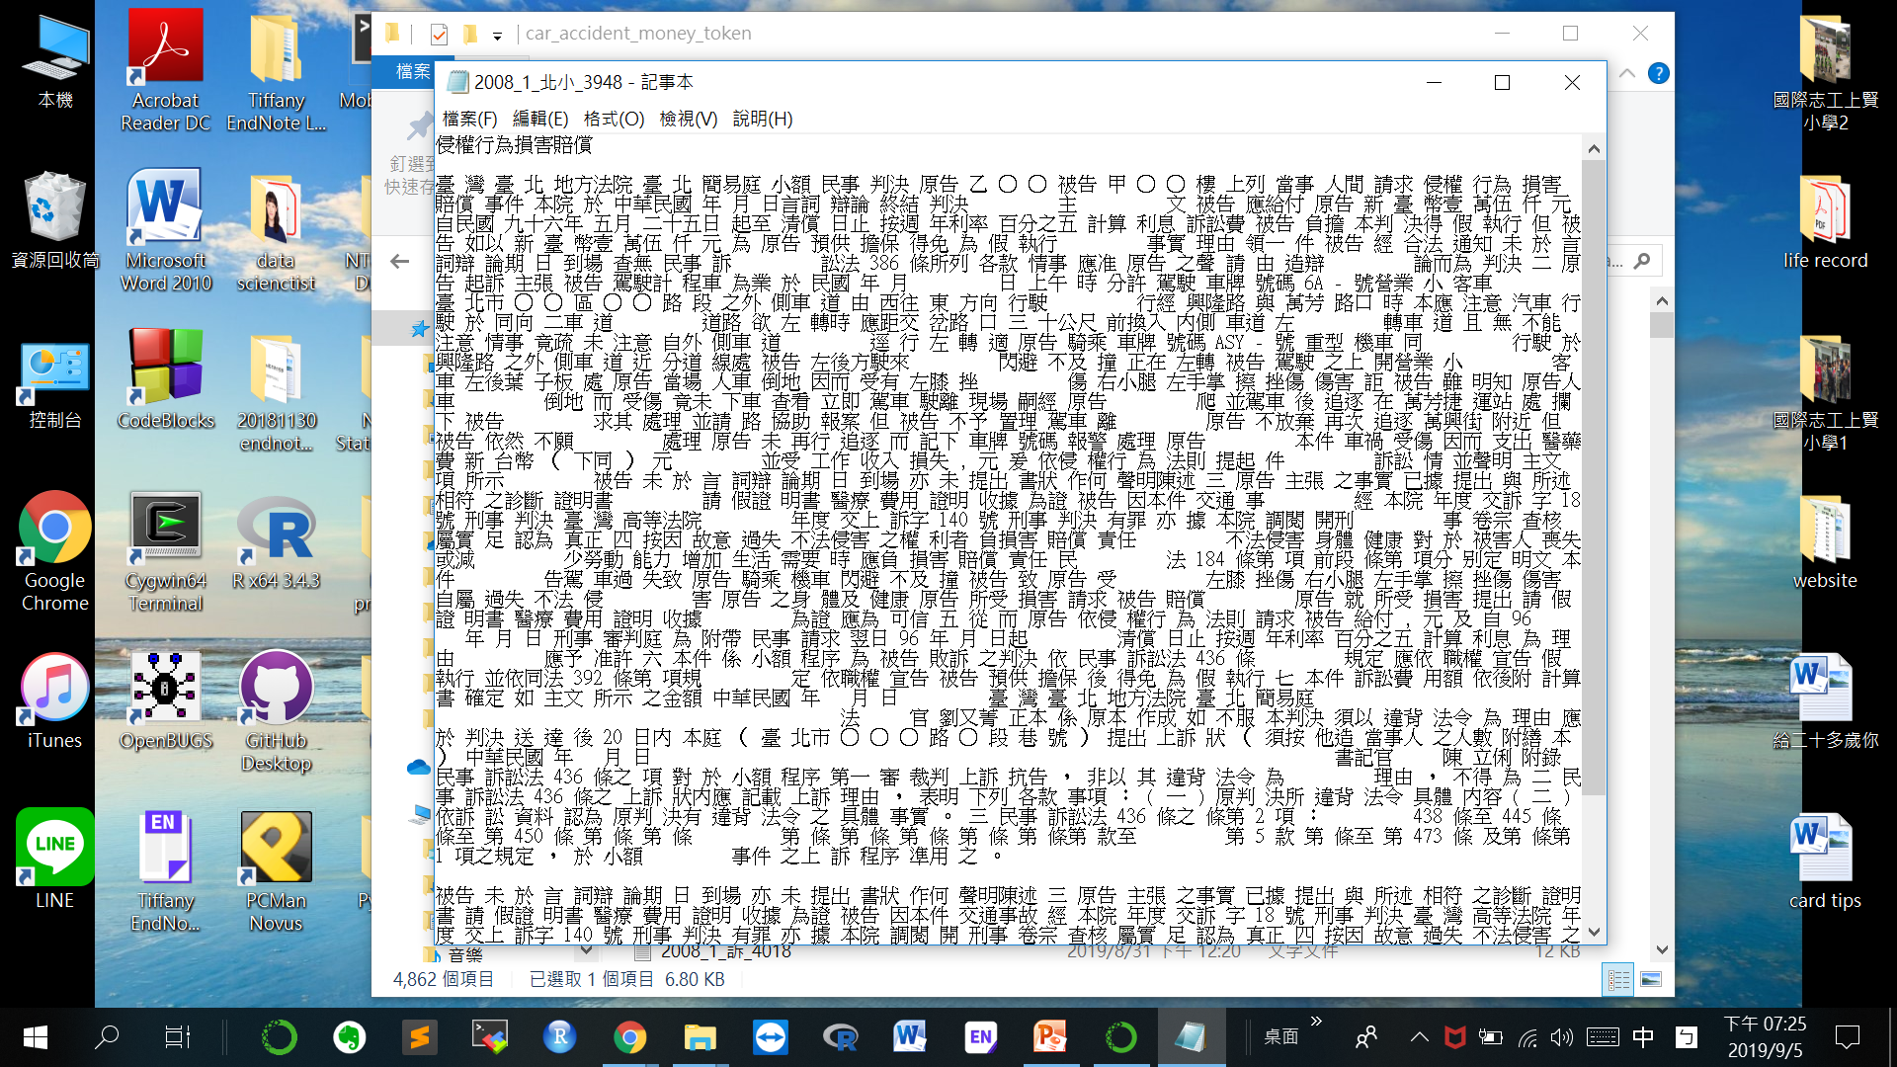
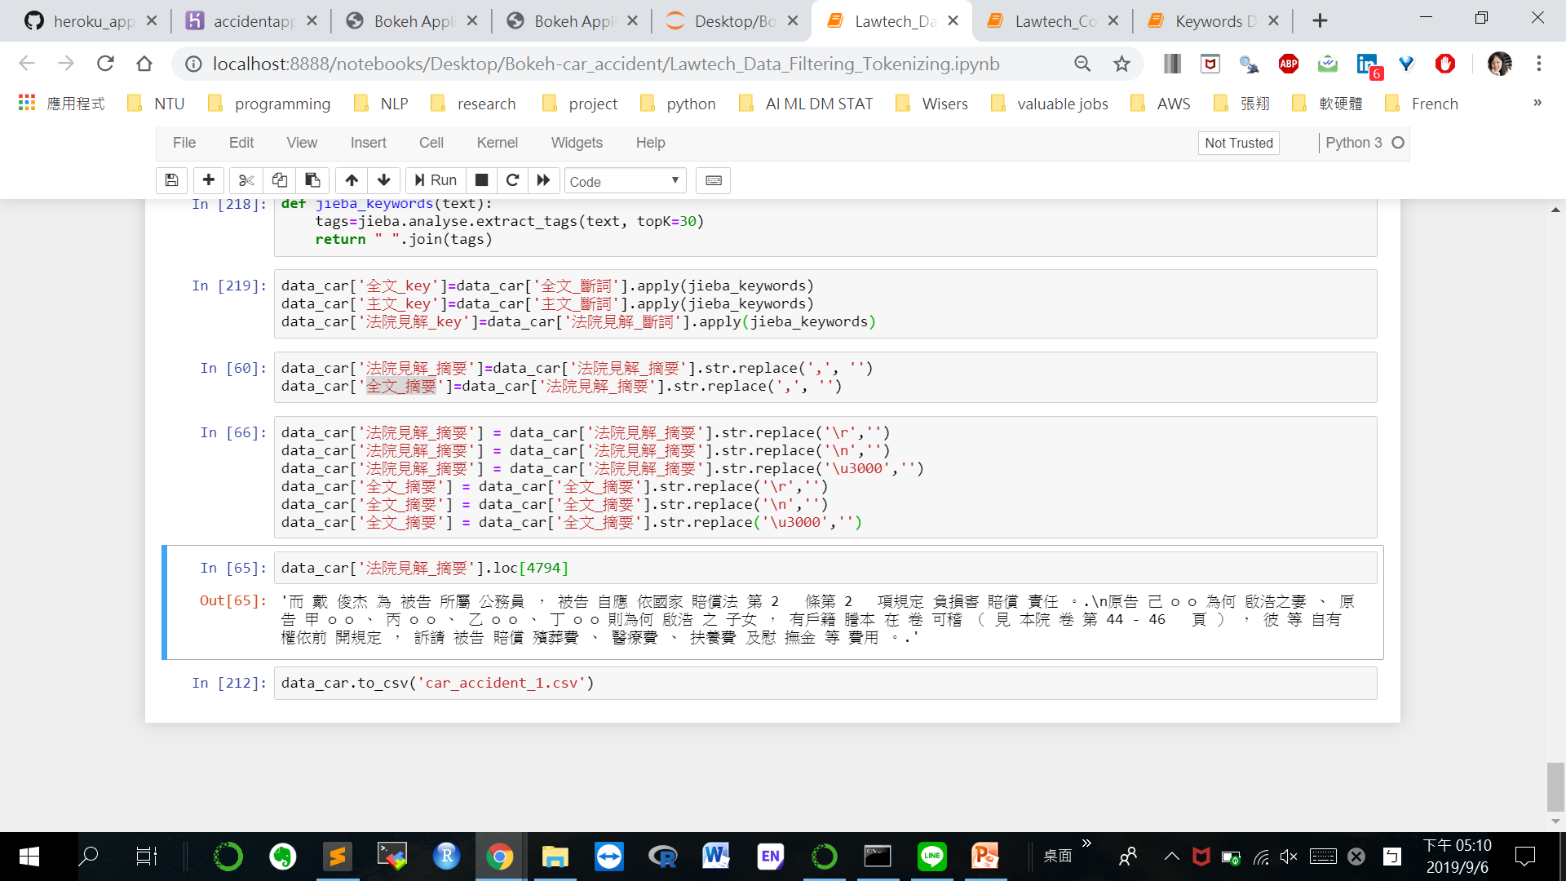
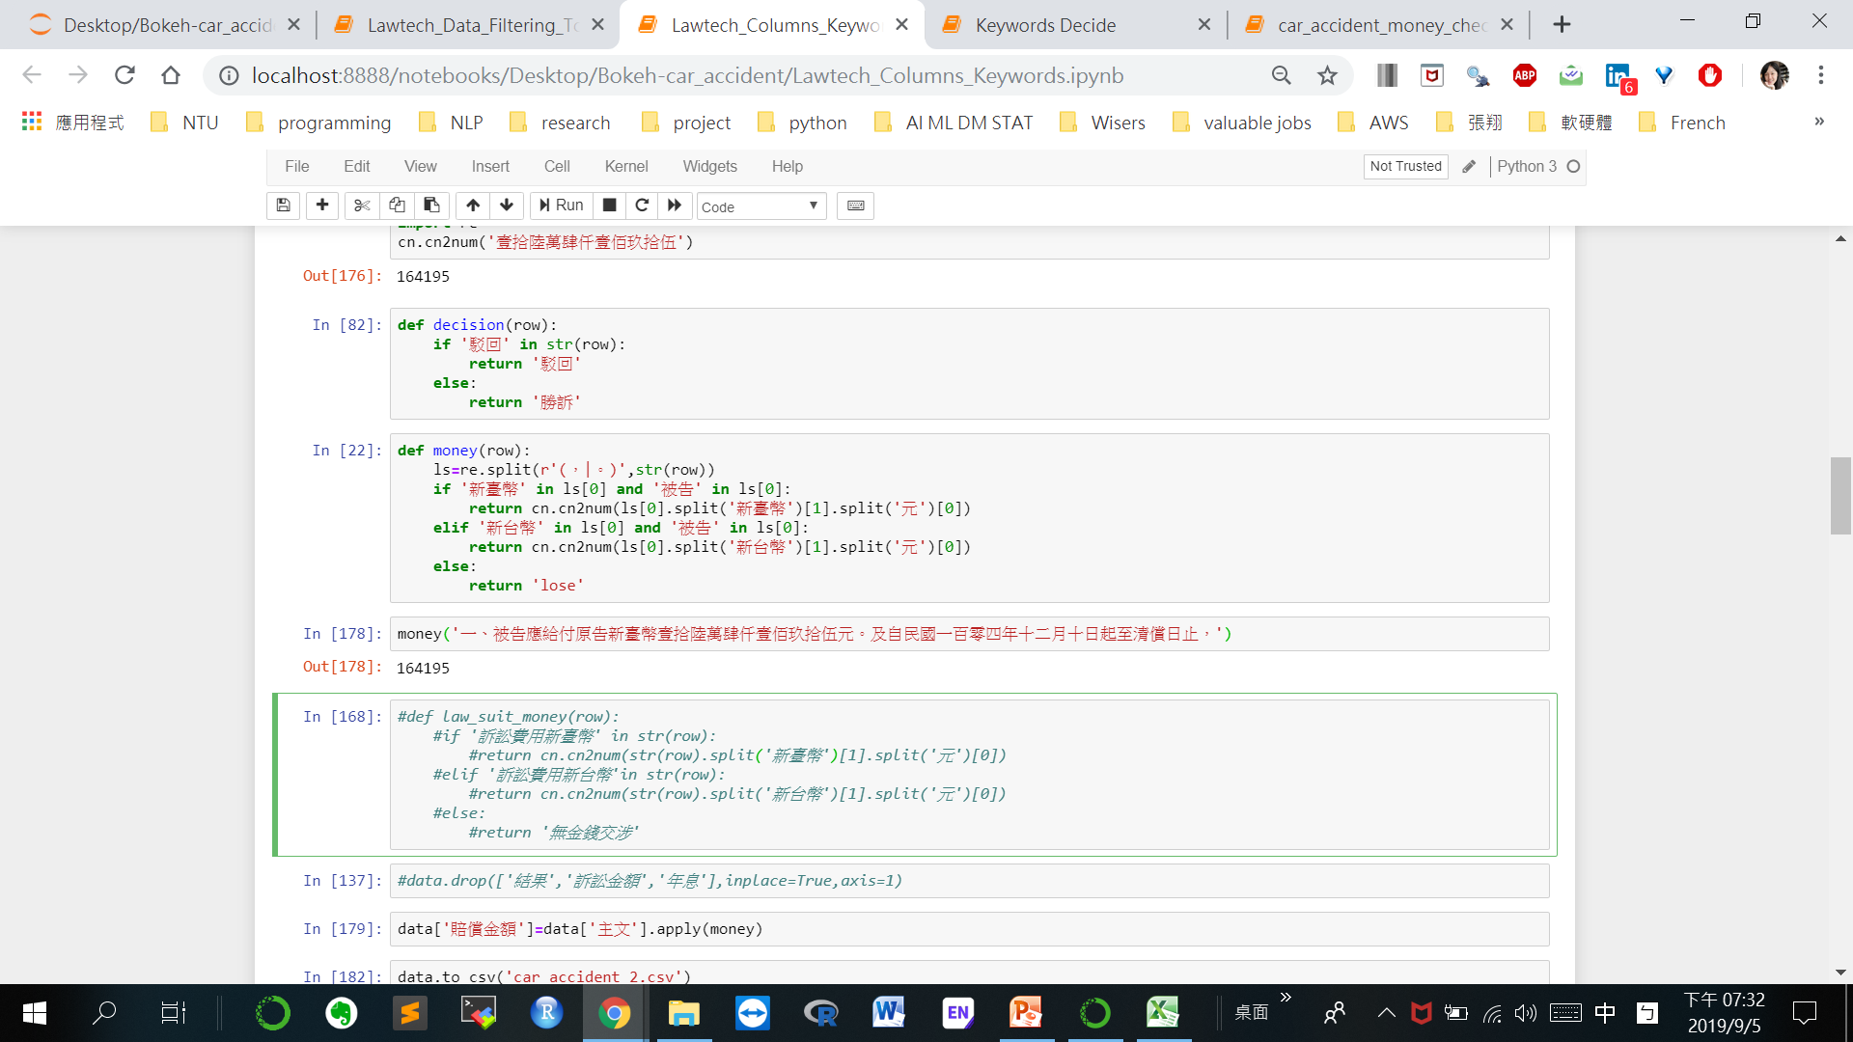
斷詞
全文摘要100詞
賠償金額
欄位設立
6426 -> 4815
Domain
Knowledge
Coding Skill
User Study

Slide 3
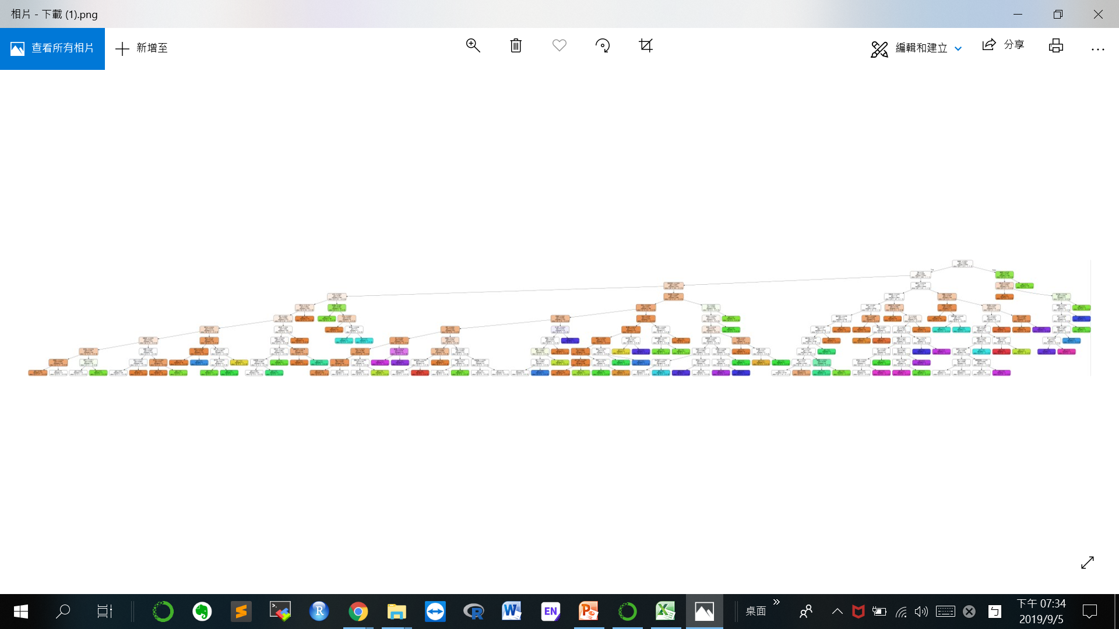
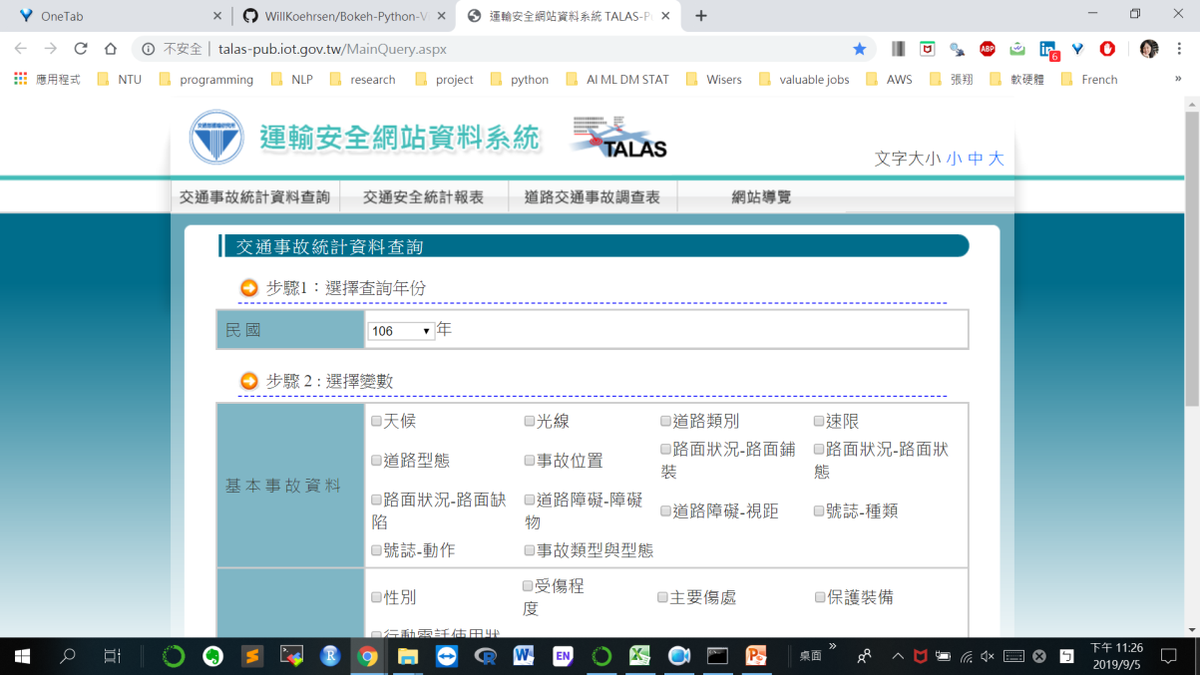
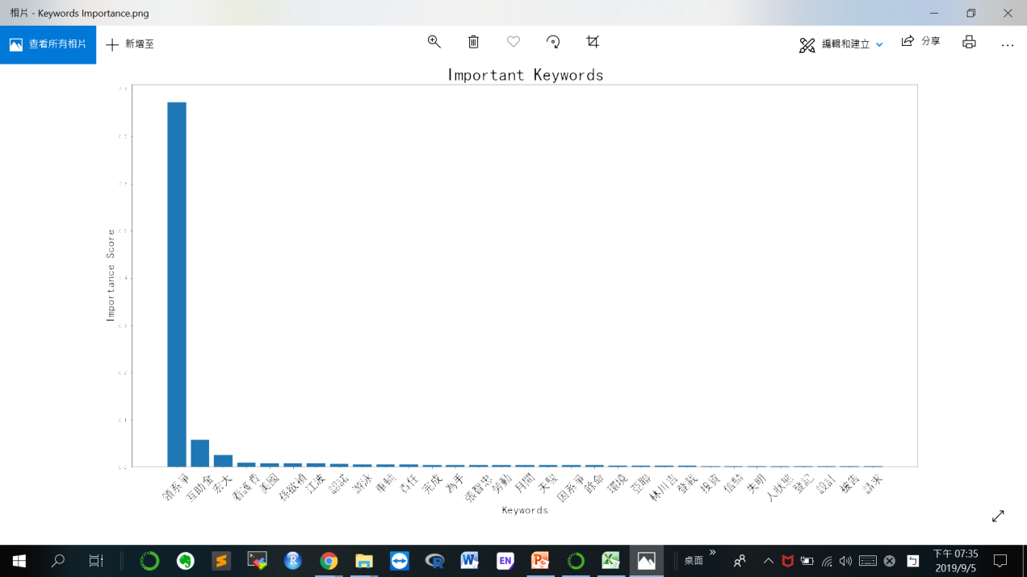
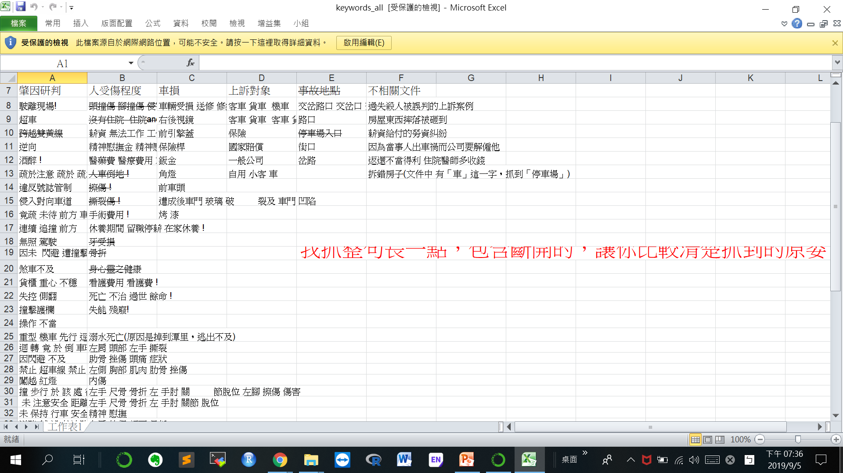
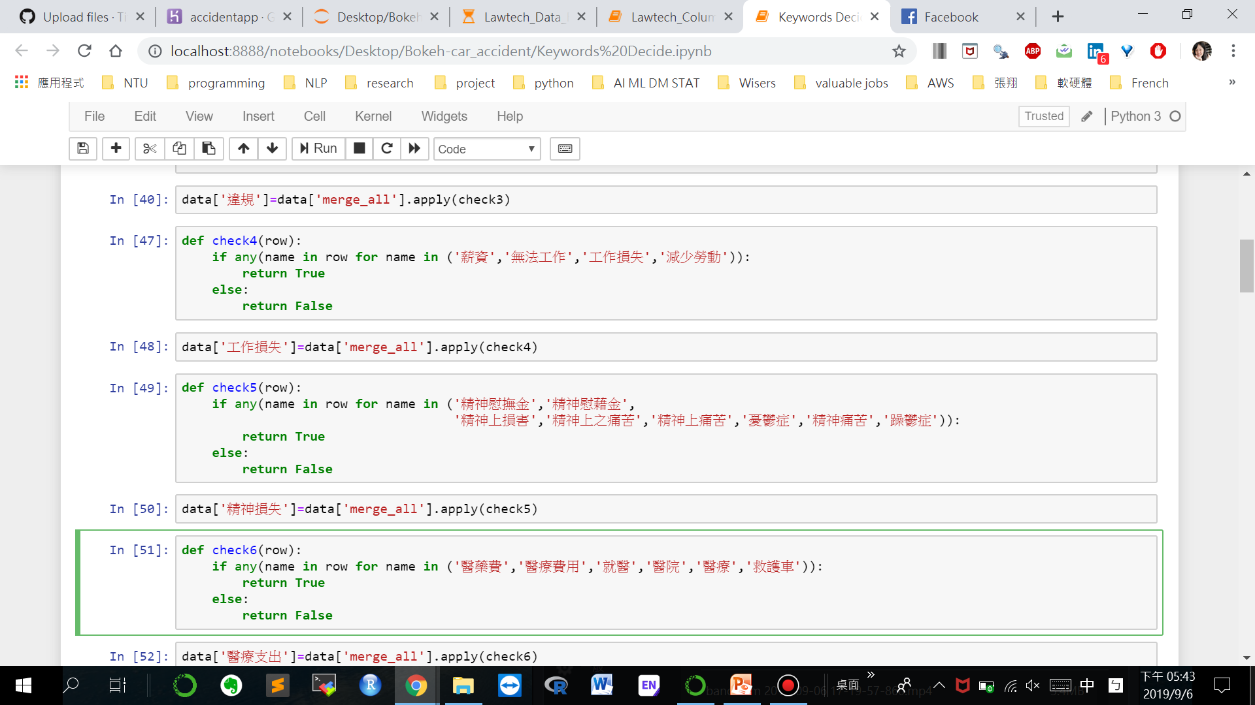
選單關鍵字確立 Model (Decision Tree) + Domain Knowledge
Domain
Knowledge
Coding Skill
User Study

Slide 4
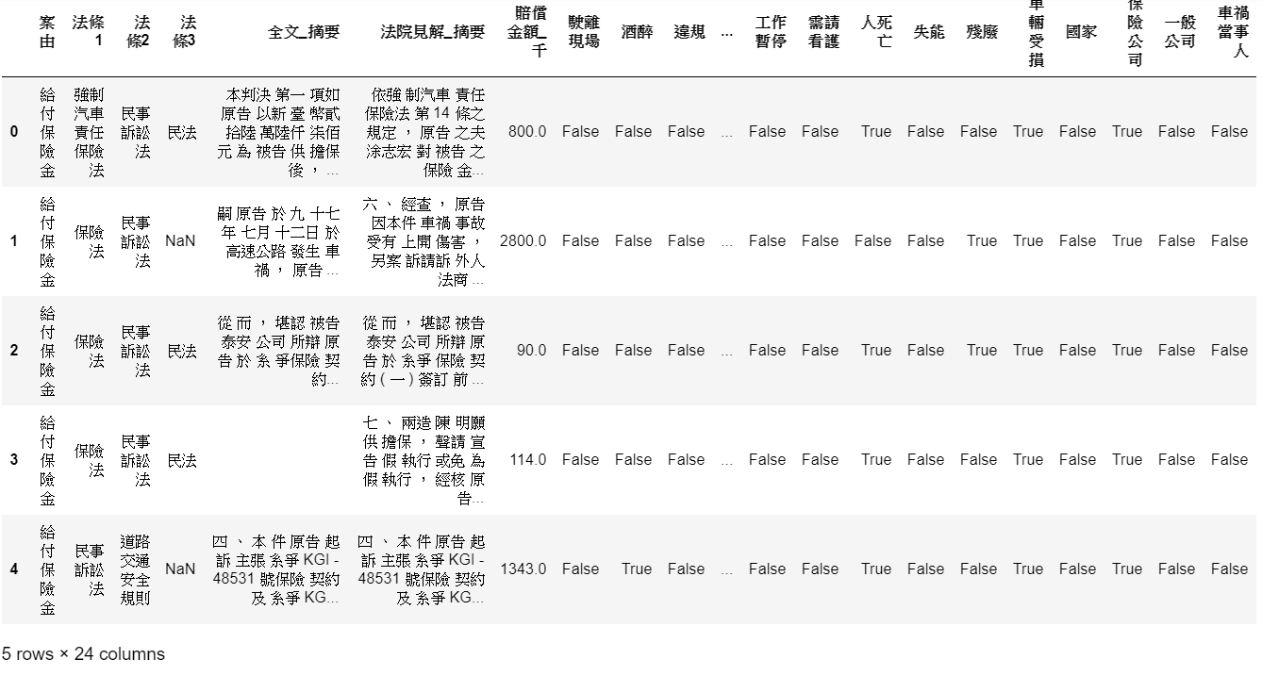
Final Dataset
文章摘要
選單關鍵字出現與否

Slide 5
Interactive Website
Visualization → Interactive Tools → App → Website
https://accidentapp.herokuapp.com/bokeh_app

